Slide 1
Movie Recommender
Group 37
Kelvin, Faris, Stefan, Stefan, Zillion

Slide 2
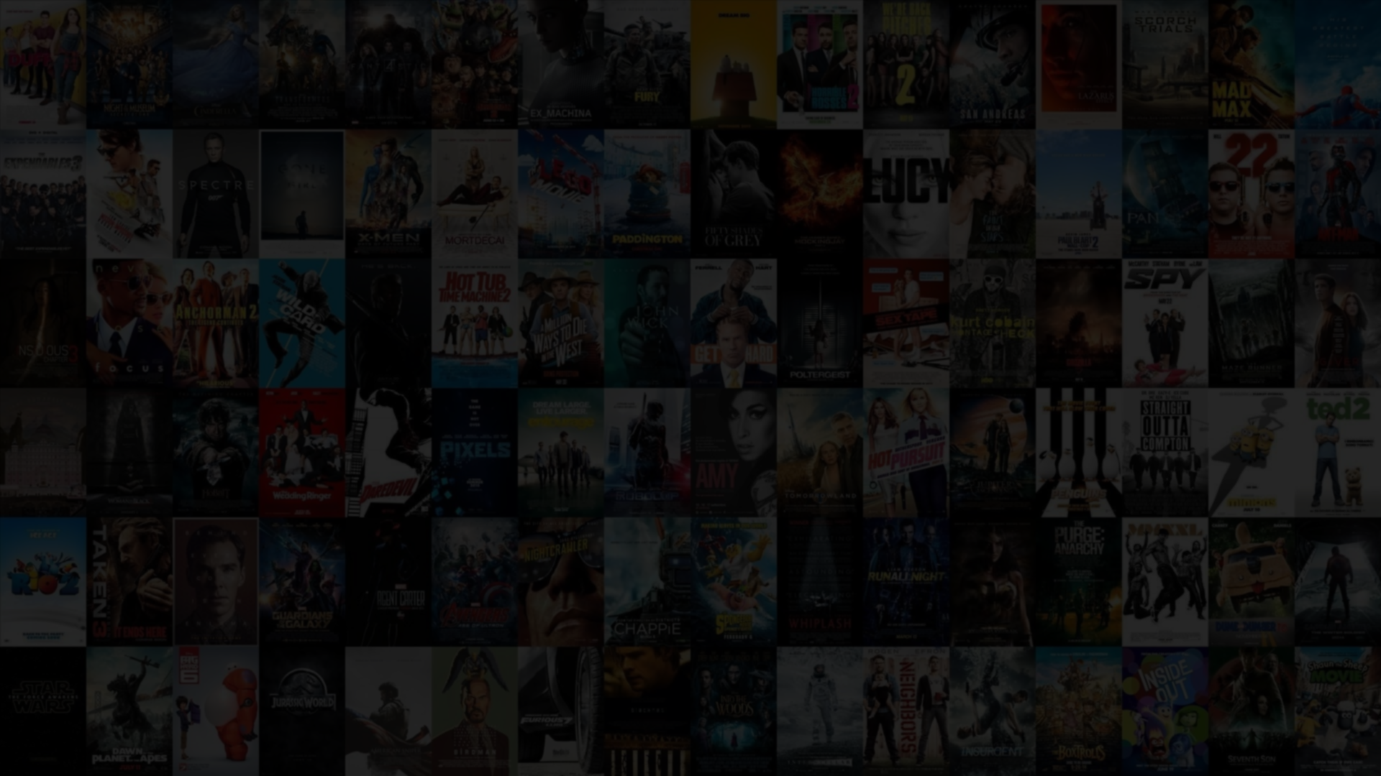
A sea of movies…
Notes:
The background of our project.
With large number of movies and rising popularity of movie streaming service, movie recommendation has become an important feature as well.
We believe that recommendation plays a great role in improving user’s experience by reducing their time in searching for their preferred movies. At the same time, it brings to light some potentially forgotten movies that nobody has bothered watching.

Slide 3
Our Aim
Extract and analyse interesting pattern from user’s movie rating behaviour to generate an accurate movie recommendation
Notes:
In recommender system, the most reliable attribute is the relationship between the user and the item. Thus, we are only interested in analyzing user’s rating behavior.

Slide 4
Dataset
MovieLens dataset obtained from GroupLens Research Repository
6,040 users, 3,900 movies, 1,000,209 ratings
Notes:
Our resource is based on dataset from MovieLens. Thanks to the GroupLens Researchers who make this data available for our use, we manage to get our hands on 1 million anonymous movie rating data on the scale of 1 to 5

Slide 5
Preprocessing
Shuffle and split to training testing (80:20)
Convert our dataset to matrix format
User1, Movie1, Rating1
User2, Movie2, Rating2
User3, Movie3, Rating3
to
 | User1 | User2 | User3
Movie1 | Rating1
Movie2 |  | Rating2
Movie3 |  |  | Rating3
Notes:
The dataset we obtained is free from any anomalies or missing values as the GroupLens researchers have performed data cleaning before releasing it.
However, some preprocessing steps are required to be done. In our case, we divide the dataset to training and testing with the ratio of 80 to 20.
We also convert our dataset format to matrix, and we will explain why in the next few slides.

Slide 6
Data Mining
We utilize Item-Item Collaborative Filtering technique to generate movie recommendation
Notes:
One of the most well known technique in recommender system is Collaborative Filtering method.
We use regression approach to solve our problem definition, and we will measure the performance of our model with Mean Squared Error (MSE)
Of course, we will explain more about Collaborative Filtering technique, mainly Item-Item / Item-Based Collaborative Filtering.

Slide 7
John likes pineapple and apple
Jason likes pineapple
Does Jason like apple?
Find out if apple is similar to Jason’s preference, which is pineapple
Recommend apple to Jason if similarity is high
Notes:
Explain item-item CF with analogy here
Change as you like

Slide 8
Movie Similarities
Cosine Similarity
Pearson Correlation
Adjusted Cosine Similarity
Notes:
The correlation computation isolates the set of users who rated both item i and j
Cosine Similarity ignores the differences in rating scale between different users. The Adjusted Cosine offsets the drawback by subtracting each user rating with the user’s average rating

Slide 9
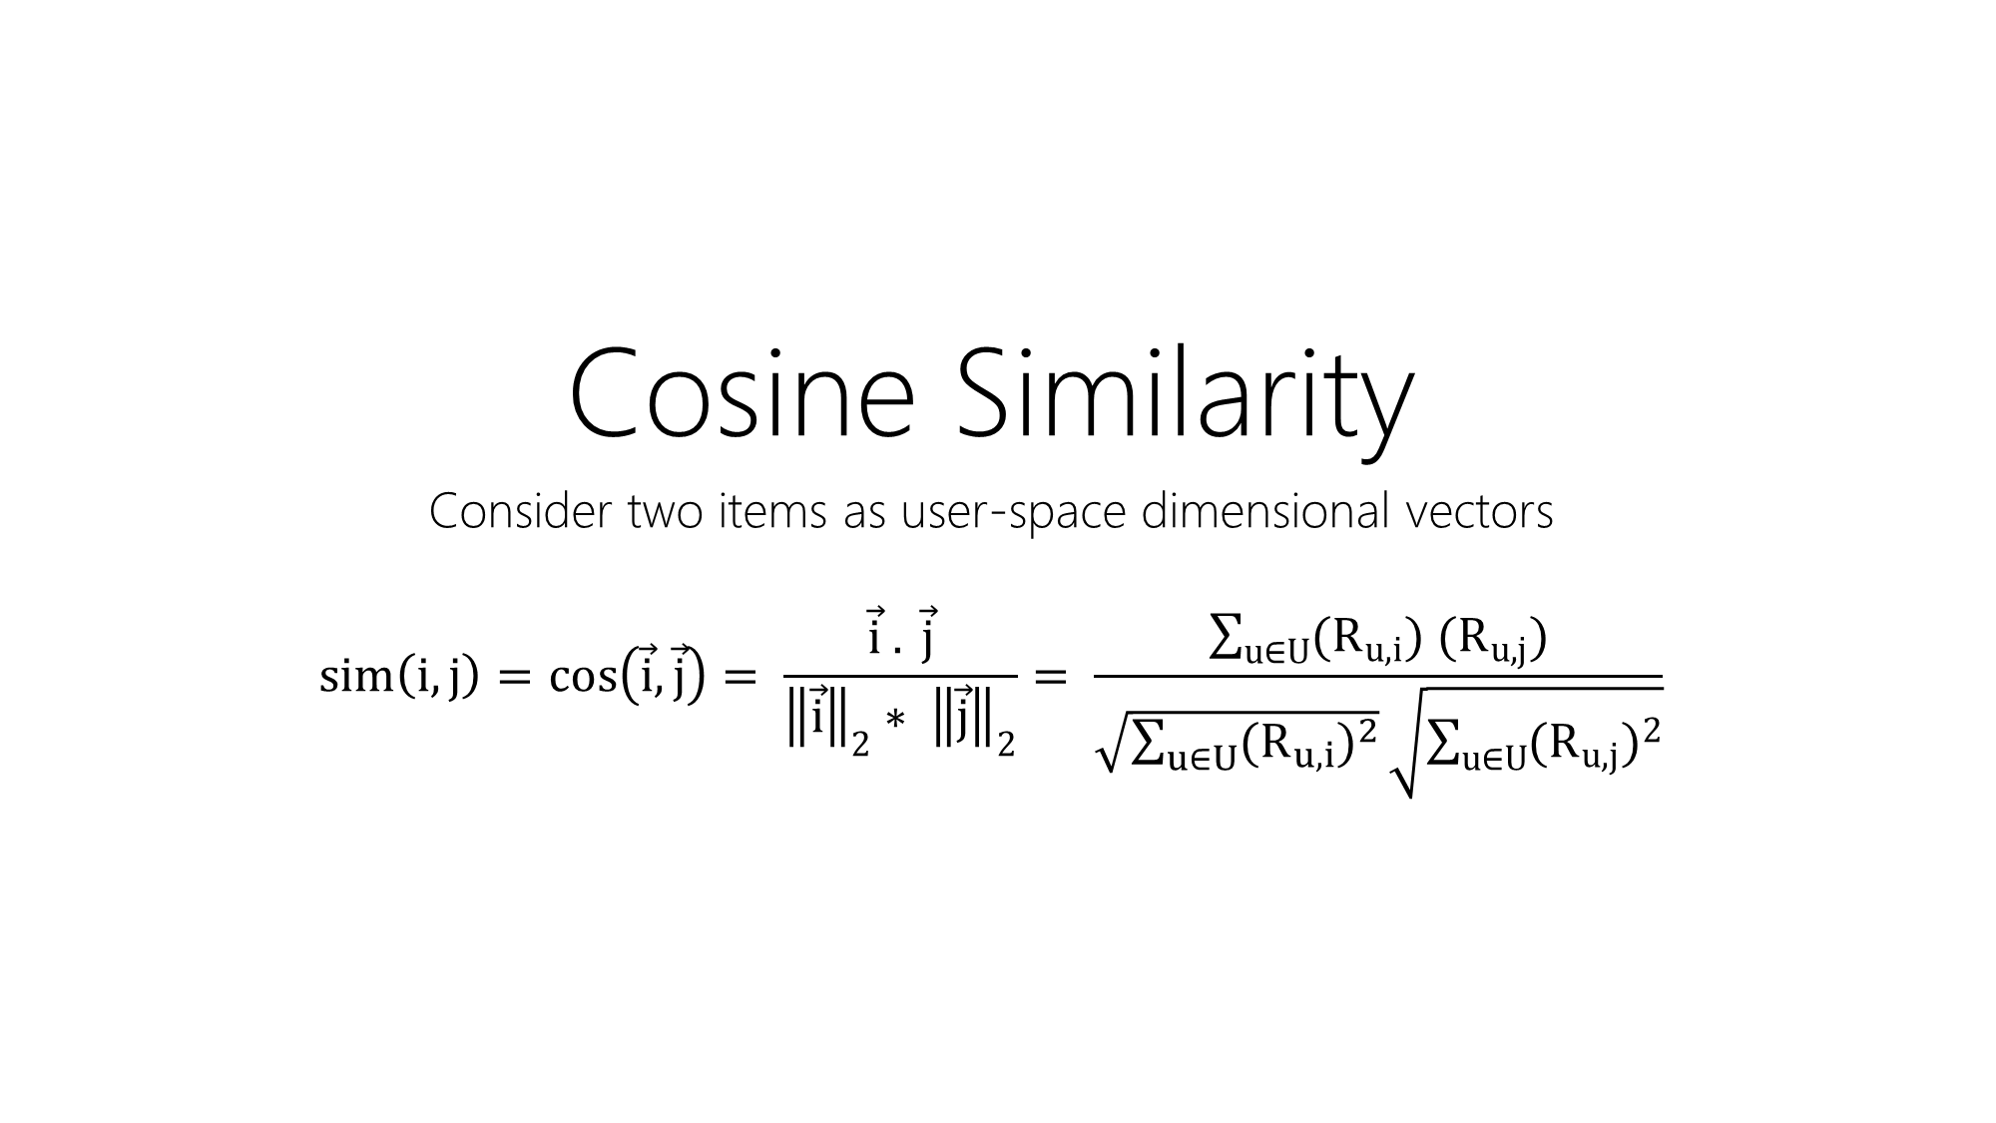
Cosine Similarity
Consider two items as user-space dimensional vectors
$$sim\left(i,j\right)=\cos\left(\vec{i},\vec{j}\right)= \frac{\vec{i} . \vec{j}}{{\left\|\vec{i}\right\|}_{2}{∗ \left\|\vec{j}\right\|}_{2}}= \frac{\sum_{u∈U}{(R_{u,i}){ (R}_{u,j})}}{\sqrt{\sum_{u∈U}{{(R_{u,i})}^{2}}}\sqrt{\sum_{u∈U}{{(R_{u,j})}^{2}}}}$$

Slide 10
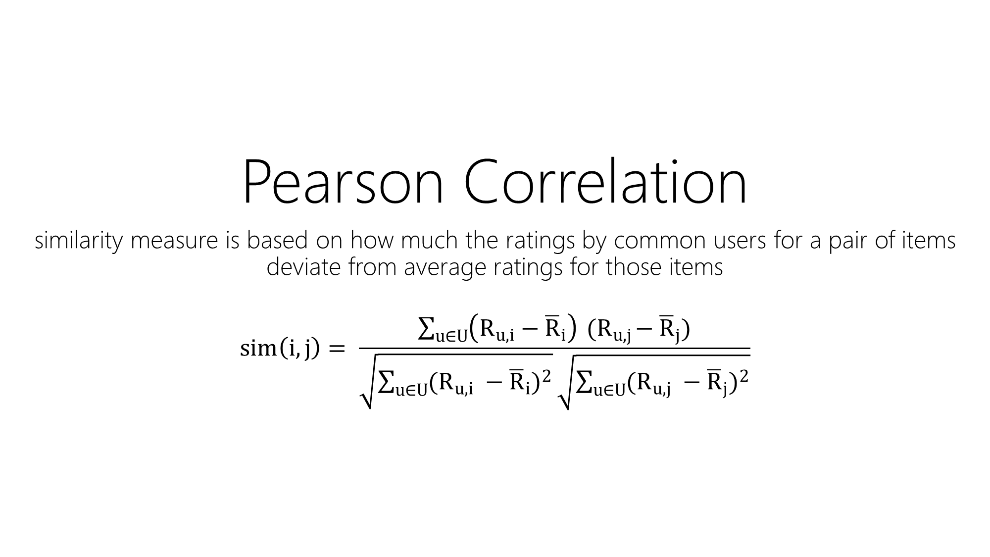
Pearson Correlation
similarity measure is based on how much the ratings by common users for a pair of items deviate from average ratings for those items
$$sim\left(i,j\right)= \frac{\sum_{u∈U}{\left(R_{u,i}−{\overline{R}}_{i}\right){ (R}_{u,j}−{\overline{R}}_{j})}}{\sqrt{\sum_{u∈U}{{(R_{u,i} −{\overline{R}}_{i})}^{2}}}\sqrt{\sum_{u∈U}{{(R_{u,j} −{\overline{R}}_{j})}^{2}}}}$$

Slide 11
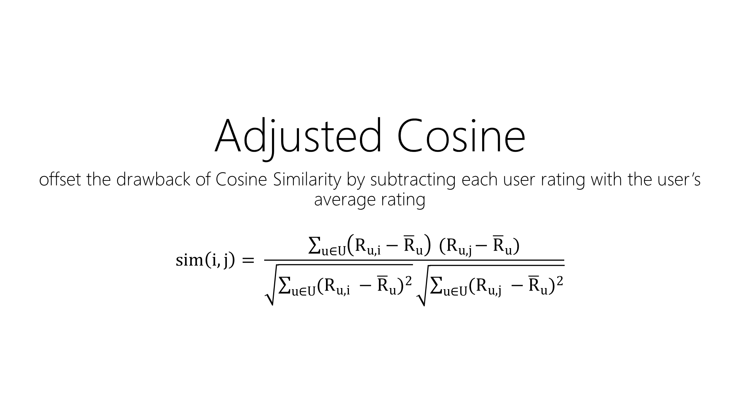
Adjusted Cosine
offset the drawback of Cosine Similarity by subtracting each user rating with the user’s average rating
$$sim\left(i,j\right)= \frac{\sum_{u∈U}{\left(R_{u,i}−{\overline{R}}_{u}\right){ (R}_{u,j}−{\overline{R}}_{u})}}{\sqrt{\sum_{u∈U}{{(R_{u,i} −{\overline{R}}_{u})}^{2}}}\sqrt{\sum_{u∈U}{{(R_{u,j} −{\overline{R}}_{u})}^{2}}}}$$

Slide 12
Cosine Similarity
Consider two items as user-space dimensional vector
Similarity between items are then computed by measuring the cosine of the angle between the two vectors
Notes:
More details in report?

Slide 13
Pearson Correlation
This similarity measure is based on how much the ratings by common users for a pair of items deviate from average ratings for those items
Notes:
More details in report?

Slide 14
Adjusted Cosine Similarity
Preprocess with data centering and shrinkage
Centering
Remove bias term from each rating
Shrinkage
Interpolating between an estimate computed from data and a fixed predetermined value
Notes:
More details in report?

Slide 15
Handling non-existent Ratings Not all user watched every single movies in our movie list A lot of missing entries in our matrix that hinder similarity computation
Initialize missing entries with 0
OR
Exclude from computation

Slide 16
Choosing K Neighbours
The step after computing similarities is to determine how many similarities to use in user’s movie rating prediction.

Slide 17

Top 10 Similarity Movies similar with “Toy Story (1995)”

Slide 18

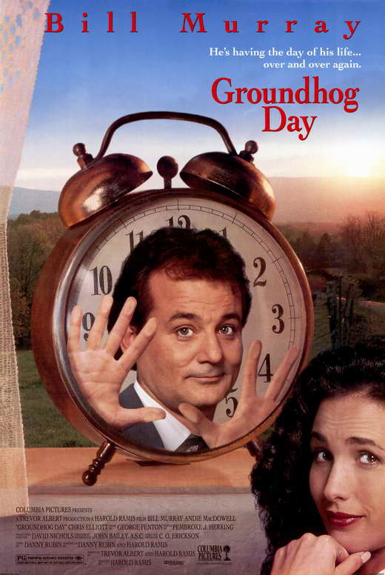


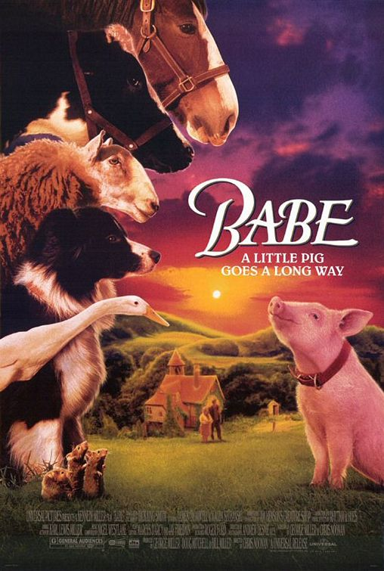
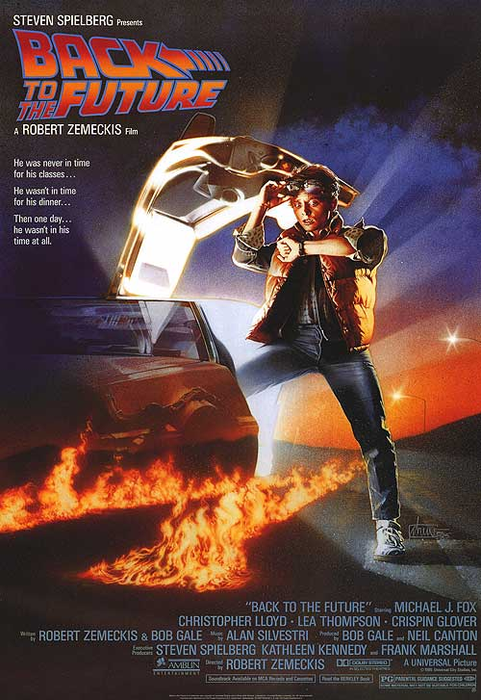



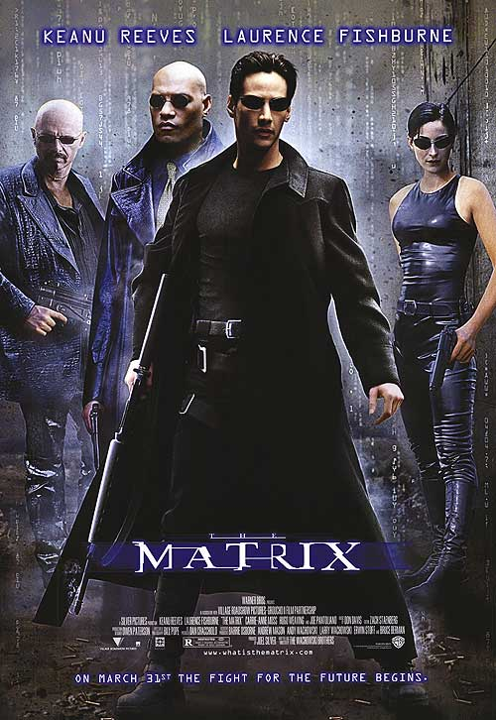

Slide 19
Computing Predictions
Weighted Sum Algorithm
Take similar items to target item
Pick items that have been rated by user
Multiply the ratings by similarities
Scale by the sum of similarities

Slide 20
Prediction with Cosine

Slide 21
Prediction with Correlation

Slide 22
Prediction with Adjusted Cosine

Slide 23
*Conclusion and Future Recommendation*

Slide 24
Thank You Question?

